Slide 1

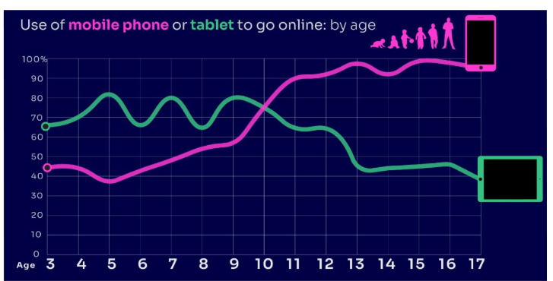

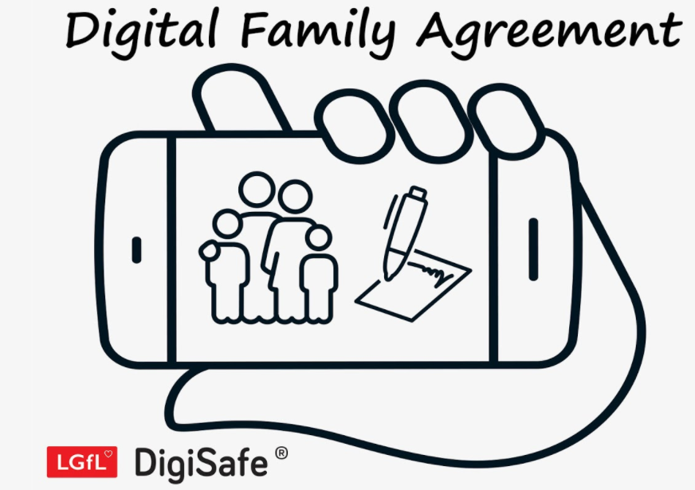
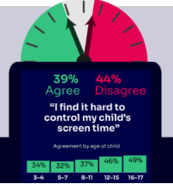

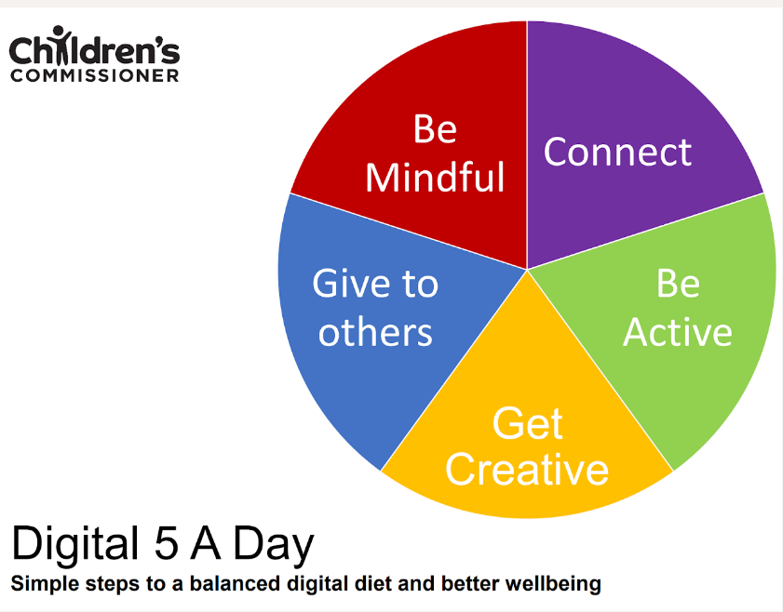

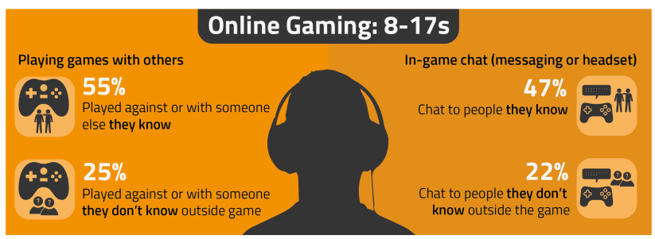


PARENT ONLINE SAFETY WORKSHOP
Notes:
This presentation brings together:
- the latest research and key findings on children’s and young people’s online use and risk
- parents’ views about their children’s media use, devices and supervision to monitor or limit use
- suggested resources and tips to empower parents to keep up with the latest trends/apps and games, manage controls and settings, and talk to children about risk - from bullying and sharing content, to extremism and gangs

Slide 2
‘We can’t protect our children from everything, but we can prepare them’
Amit Kalley Co-Founder, For Working Parents.
Notes:
As the parents come in, have this on pieces of paper. Encourage parents to annotate what this means with regards to online safety.
Discuss the fact that the digital world is everchanging and we need to equip them with the tools to manage
Teaching them how to recognise red flags, such as strangers asking for personal information.
Helping them understand privacy settings and digital footprints.
Encouraging them to talk openly about anything that makes them feel uncomfortable online.
Showing them how to block, report, and seek help.
Building critical thinking so they can question what they see and read.
dangers online

Slide 3

Warning!
Notes:
Some of the content from this presentation may be sensitive or upsetting for parents/carers.

Slide 4
Which is safer, the physical world or the online world?
Notes:
Ask the parents to think about this maybe discuss
🌍 The Physical World
Safer because:
You can usually see risks around you.
Trusted adults, CCTV, and community rules offer protection.
Schools and public places have clear safeguarding systems.
Less safe because:
Physical harm can happen quickly.
Strangers can approach you in person.
Accidents and environmental dangers exist.
🌐 The Online World
Safer because:
You can block, report, and control who contacts you.
You don’t have to share your real identity.
You can leave a situation instantly by logging off.
Less safe because:
People can hide who they really are.
Content spreads quickly and is hard to remove.
Cyberbullying and scams can happen 24/7.

Slide 5
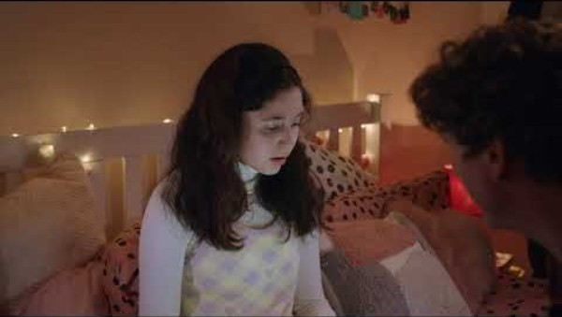
https://youtu.be/EKUgIDDP1aw?si=qvYK1fRf4WDXIKH8
Notes:
Explain that I will share quite a hard hitting video about online safety to get us to think about the next part of our session
https://youtu.be/EKUgIDDP1aw?si=qvYK1fRf4WDXIKH8

Slide 6


TALKING TO YOUR CHILD ABOUT LIFE ONLINE

Slide 7

What are you most WORRIED about when your child is ONLINE?
Notes:
ASK: Find out what parents are currently worried about – discussion if some parents reluctant to share
TELL: Despite the positive finding that over seven in ten (72%) 8-17-year-olds who use messaging/social media sites or apps feel safe when using these apps/online sites, either all or most of the time, the online space is a risky environment for children.

Slide 8
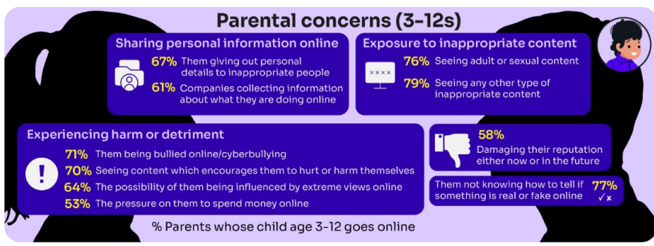
Summary of parental concerns (3 – 17 yr-olds)
Source: Children and parents: media use and attitudes report 2025
Notes:
Many parents indicate that they have concerns around various aspects of their children’s online activities.
The primary worry of all parents of online 3-17s continues to be potential exposure to age inappropriate content - three-quarters of parents said they were either fairly or very concerned about their child seeing content which is not appropriate for their age (76%) and the same proportion were concerned about them seeing ‘adult’ or sexual content (74%).
72% were concerned their child not knowing how to tell if something is real or fake online.
Seven in ten (69%) parents fear their child might be bullied online,
A similar proportion (68%) are worried about them seeing content that encourages them to hurt themselves.
61% of parents are concerned about their child being influenced by extreme views,
51% worry about the pressure to spend money online.
Unsurprisingly, there are many concerns which are more prominent among parents of younger (3- 12-year-old) children who go online.:
For example, a higher proportion of these parents compared to their counterparts (parents of teenagers) are concerned about their child being exposed to age inappropriate content (79% vs 69%), their child not being able to tell what is real or fake online (77% vs 64%), their child seeing content which encourages them to harm themselves (70% vs 63%), the 36 child giving out personal details to inappropriate people (67% vs 60%) and the possibility of their child being influenced by extreme views online (64% vs 57%).

Slide 9
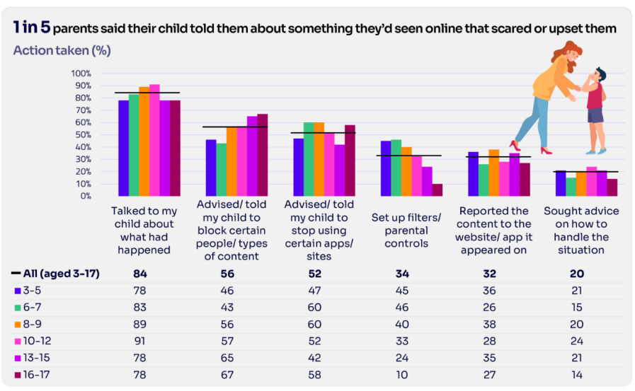
Are you CONFIDENT to TALK TO YOUR CHILD?
Is your child confident to TALK TO YOU?
Be open
Be honest
Source: Children and parents: media use and attitudes report 2025
Notes:
Almost all the parents in this group (99%) took some type of action in response to being told that their child had seen something that scared or upset them:
Over four in five parents in five (84%) had spoken to their child about what had happened.
Over half said they had advised their child to block a specific type of content or person (56%) and/or recommended that their child stop using certain apps or sites (52%).
Notably, there has been an increase this year in parents setting up filters or parental controls after an incident of this nature, up from 23% last year to 34% this year
However only about a third (32%) of parents had reported the content to the site or app on which it appeared
TELL:
You do not need to be an IT expert to help your child stay safe online. One of the best things you can do to protect your children is to talk regularly with them about their use of technology- just as you do with all other areas of parenting.
Having an open and honest approach is best - reacting, without involving them or talking to them, can often push behaviour underground, so it still happens, but you are less likely to know about it. This can increase risk to your child.

Slide 10
What questions could you ask your child about their online activity to encourage open conversation?
Notes:
Have this on pieces of paper for parents to note their ideas

Slide 11
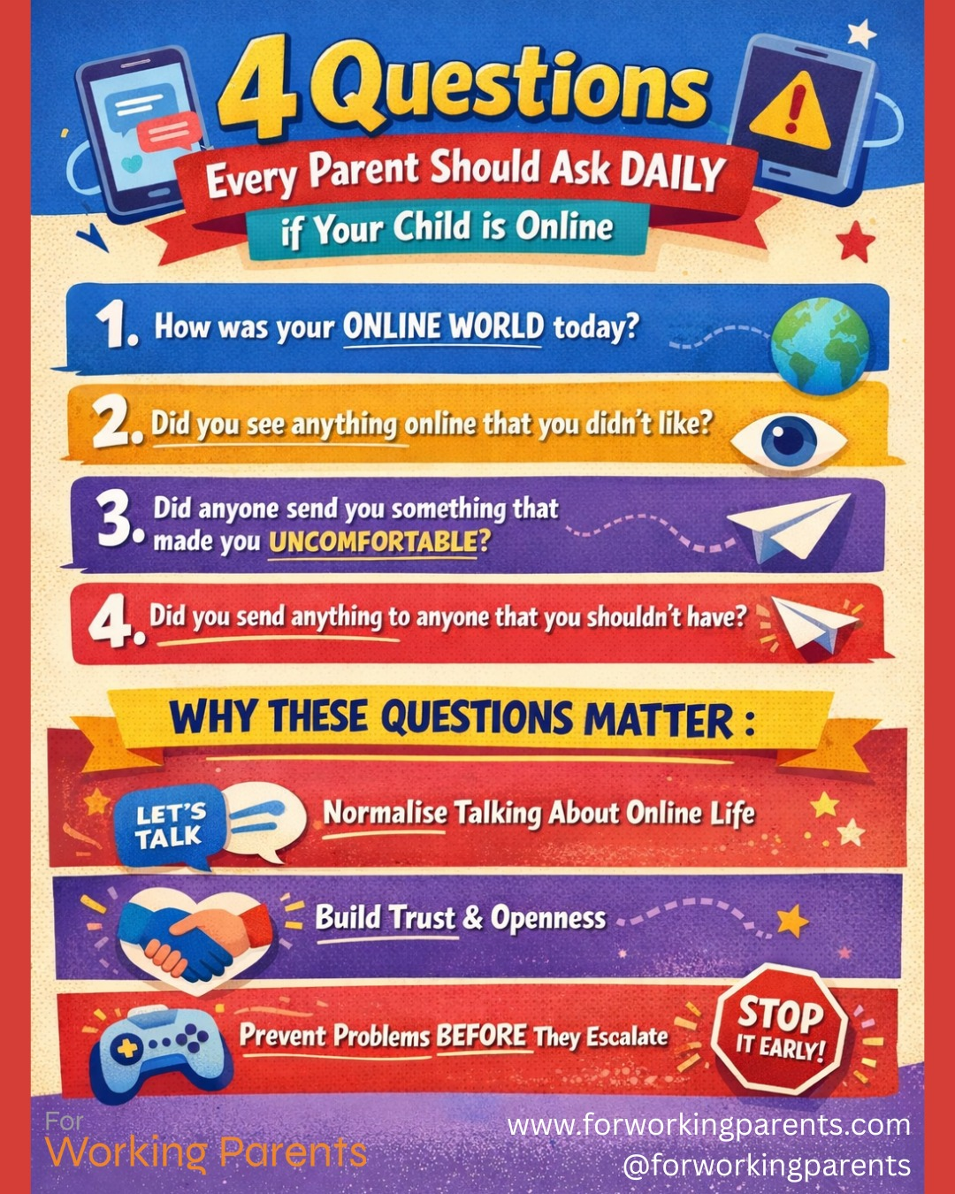

Slide 12
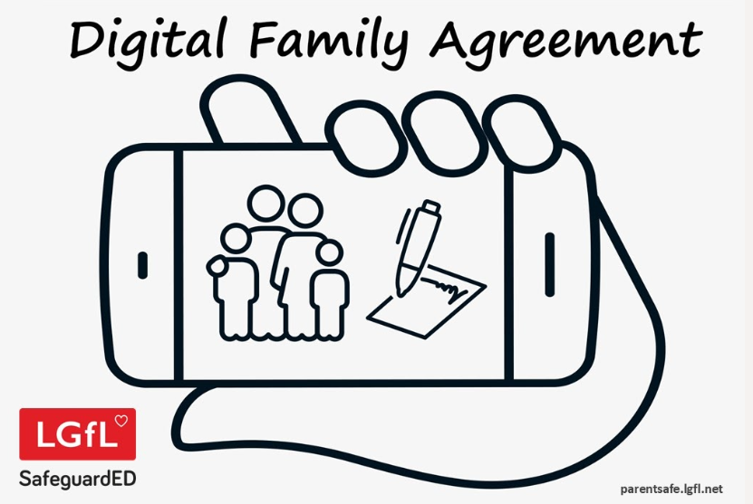
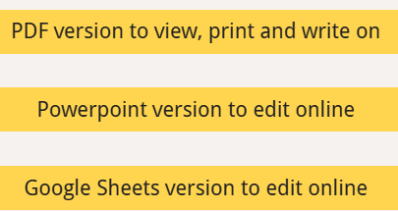
Why not have a family agreement to:
clarify what is allowed...or not
establish ground rules like no phones at the table or in the bedroom at night-time
agree shared expectations to reduce arguments and keep everyone safe & healthy
Download it at parentsafe.lgfl.net/digital-family-agreement
Notes:
TELL:
To help facilitate this, LGfL have created a free digital family agreement that parents could sit down and populate with all family members to agree what is and is not allowed within their family around tech use. This includes parents! WE as parents also need to role model good behaviour.

Slide 13
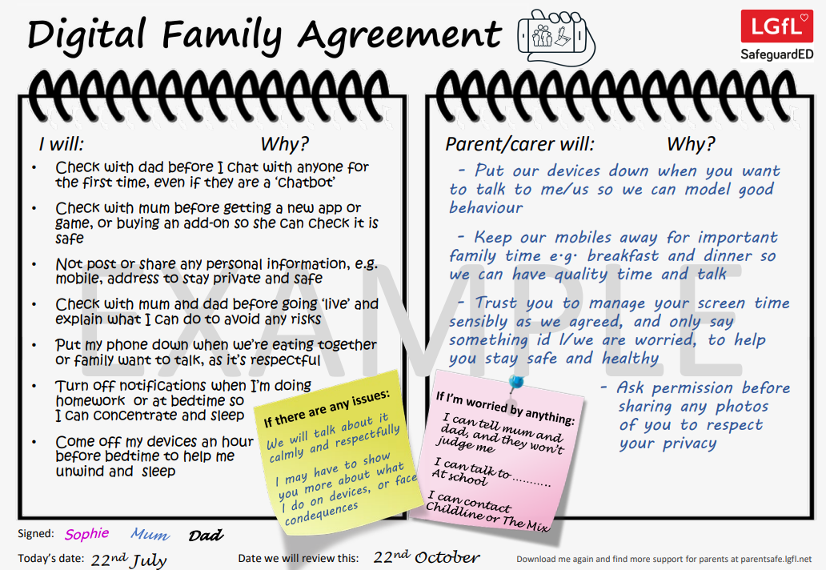
parentsafe.lgfl.net
Notes:
TELL - This is an example of a completed agreement – you may wish to take them through the sample statements to help them get started.

Slide 14
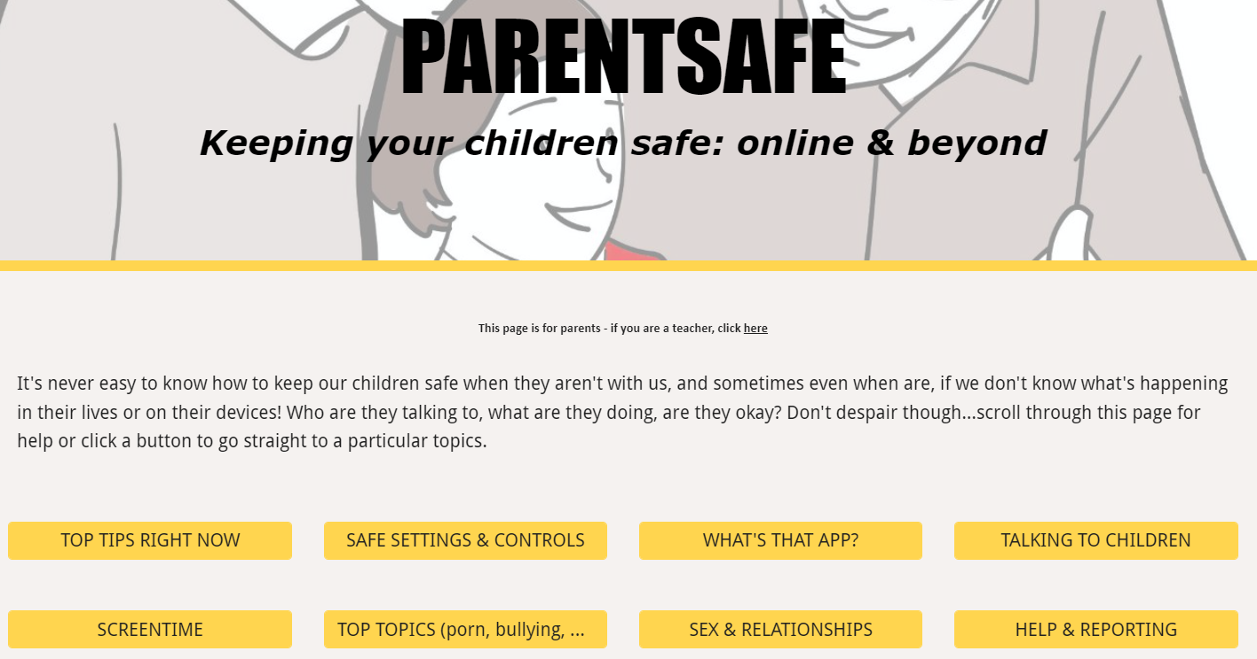
parentsafe.lgfl.net
Notes:
We can’t know everything but we can find resources to help us to manage online behaviour

Slide 15
SUPERVISION AND PARENTAL CONTROLS

Slide 16
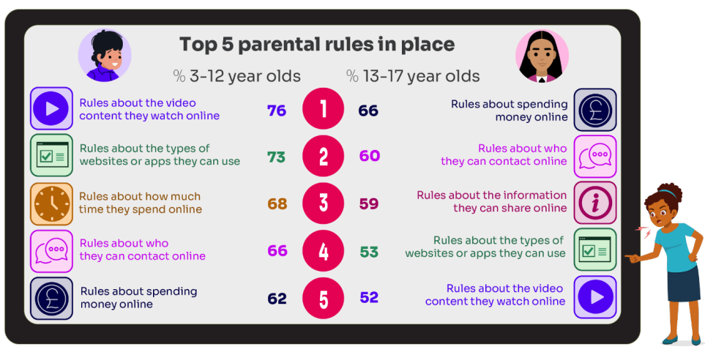
What RULES do YOU SET about being online?
What do you do that WORKS?
While parental concerns in some areas have increased considerably, their enforcement of rules appears to be diminishing, partly due to parents’ resignation about their ability to intervene in their children’s online lives.
Source: Children and parents: media use and attitudes report 2025
Notes:
ASK: What rules do you set for your children? How confident are you in implementing them?

Slide 17
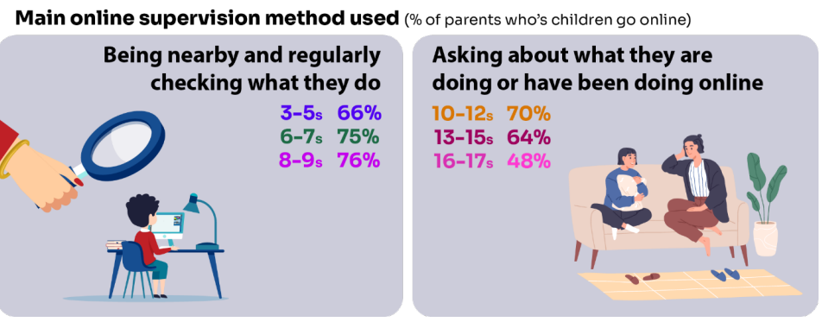
Do you SUPERVISE your child’s online activity? HOW?
Source: Children and parents: media use and attitudes report 2025
Notes:
TELL - The two most commonly-employed types of parental supervision among parents of 3-17s are to:
ask their child about what they are or have been doing online (59%), and
be nearby and regularly checking what their child does (55%).
Of course, this varies as the child gets older and more independent, as parents decreasingly monitor their child’s online life

Slide 18

Have you set up parental CONTROLS/PRIVACY SETTINGS for ALL DEVICES and NETWORKS?
Controls need to be set up on both the broadband connection AND each individual device
These do not come as standard so it’s worth checking
They are important because they allow you to:
  Block and filter upsetting or inappropriate content or sites
  Plan what time and how long your child can go online for
Notes:
TELL – it is important that these controls are set up on BOTH the broadband connection AND each individual device
About seven in ten (73%) parents of all 3-17-year-olds use at least one type of technical tool or control to manage their child’s access to online content; parents of 8-11-year-olds are more likely than those of older children to use at least one of these tools (84% vs 70% of parents of 12-15s and 54% of parents of 16-17s respectively). The most commonly-used technical tool used, across all parents of 3-17s, were parental controls built into the device by the manufacturer, e.g. Windows, Apple, Xbox, PlayStation etc. (32%). (Ofcom 2024)

Slide 19
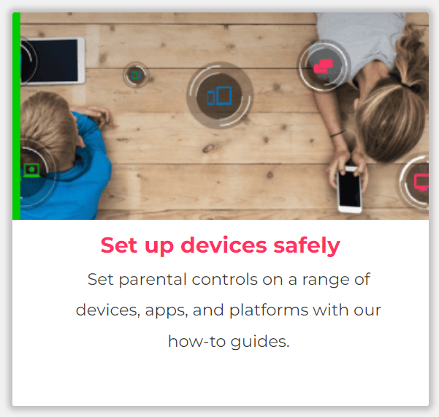
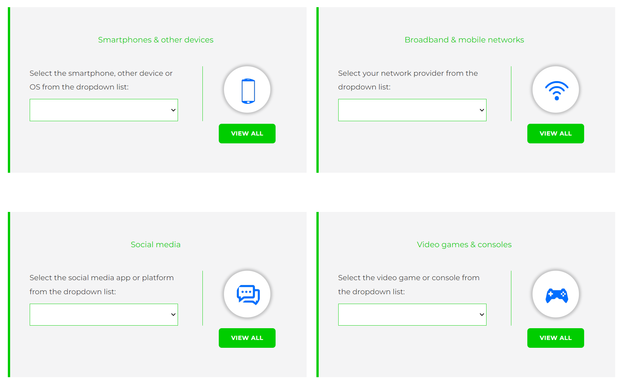
Visit internetmatters.org/parental-controls to find out how to set controls on devices:
Notes:
TELL – They can use this great page to find out how to set up controls on any smartphone, broadband, social media site/app and games console
Show this on the website – show a video from BT provider
REMIND - They need to set up parental controls on each of these individually

Slide 20
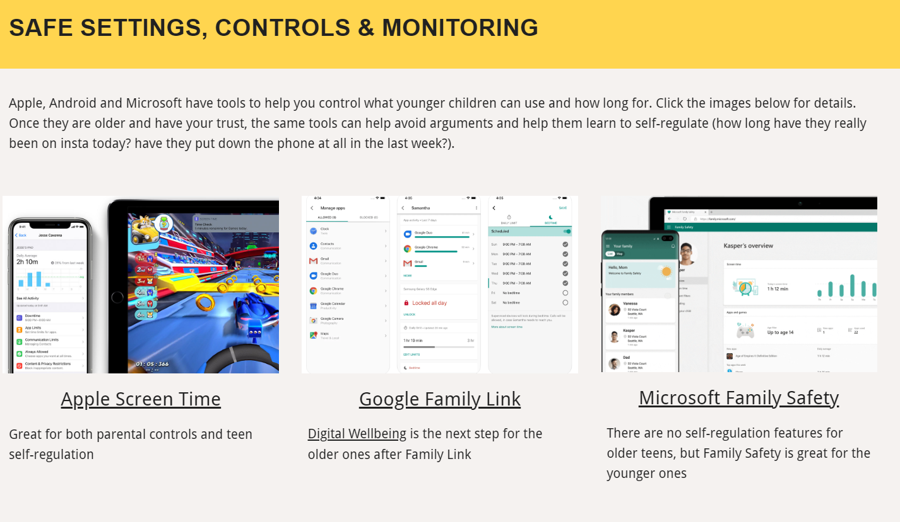
Parental control apps like Google Family Link, Screen Time and Microsoft Family can let you set limits across devices, apps and platforms
Video guidance
Visit parentsafe.lgfl.net/ for additional advice and tips on settings and controls for all devices
Notes:
EXPLAIN - As well as setting controls on your broadband, device, apps, games etc, Parental Control Apps like Google Family Link, Screen Time and Microsoft Family can further enhance safety by letting you set limits across devices, apps and platforms without needing to access these spaces separately. You can manage screen time, app access, inappropriate content restrictions and more.
Screen Time shows you how much time you spend on apps, websites and more. You can also set limits and restrictions for what you want to manage – on your own device or a child's device.
Family link can run on Android devices, e.g. Samsung… Parents can access and manage their child’s account and settings, and delete it if necessary
Show the video so parents are aware of what these controls can do

Slide 21


REMEMBER
As children get older, restrictions and controls you use will change, but only at a pace you feel is appropriate for your child, not pressure from your child “because everyone else is allowed”
Content filters are never 100% effective, at some point your child may come across inappropriate or upsetting content, so make time to talk regularly

Slide 22
APPS

Slide 23
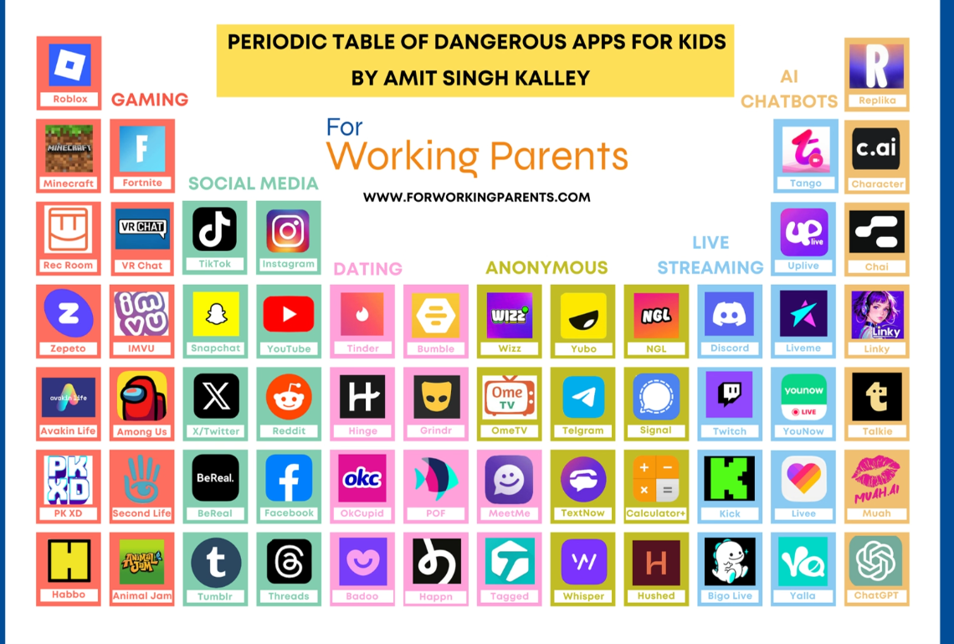
Notes:
Not to know all of these but to go away and research what these apps are if your children are using them. Talk to them about how they use them.

Slide 24
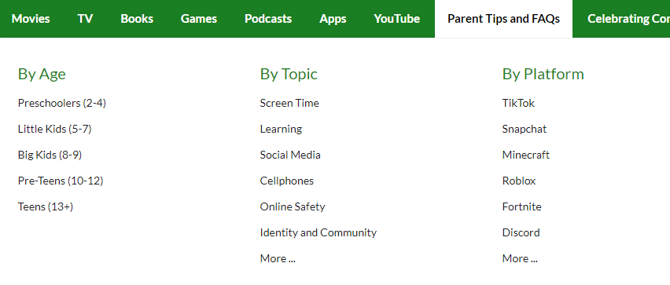
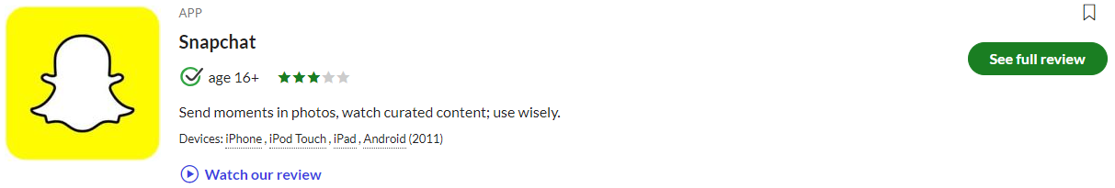

Find ratings and reviews for parents on apps, games and social media at commonsensemedia.org
Notes:
REMIND – they don’t need to be experts, but they can empower themselves by finding out about the suitability of the games/apps their child uses
SHOW – the Common Sense Media page and pick an app or game to show how easy it is to find a review

Slide 25
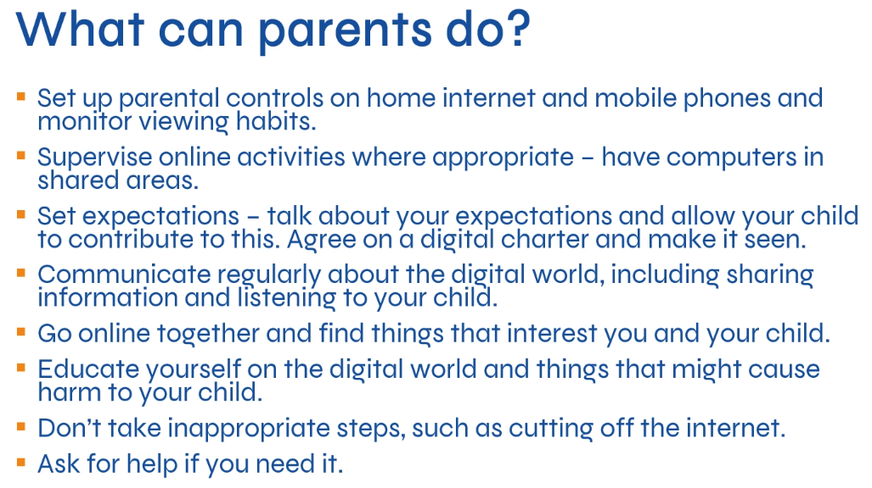

Slide 26
‘We can’t protect our children from everything, but we can prepare them’
Amit Kalley Co-Founder, For Working Parents.

Slide 27
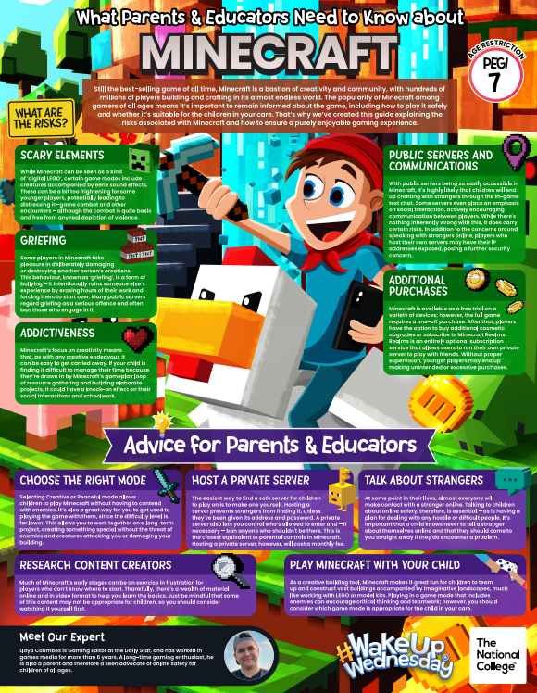
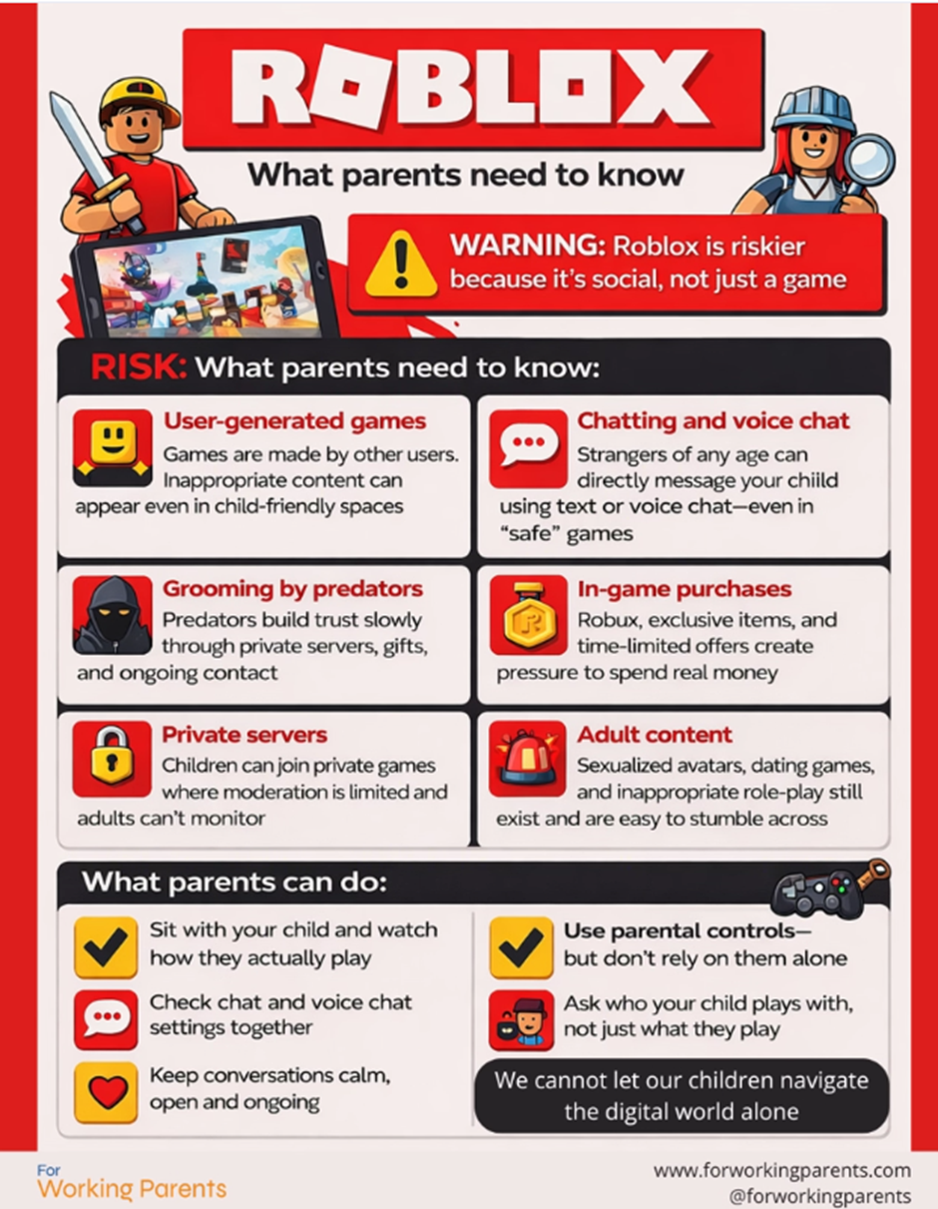
Joining Public Servers = Interaction with strangers
Quick Parent Tips
-Use private servers or single-player for younger children
-Disable chat where possible
-Keep devices in shared spaces
-Agree clear time limits before play starts
-Talk regularly about who they play with and what they are building
Practical Safeguards for Parents
-Set up a parent account and use parental controls
-Restrict chat to “Friends” or disable it for younger children
-Turn off private messaging
-Use spending limits or disable purchases
-Keep devices in shared family spaces
-Have regular conversations about online friendships
Privacy setting Minecraft
Making Roblox Safe Video Tutorial

Slide 28
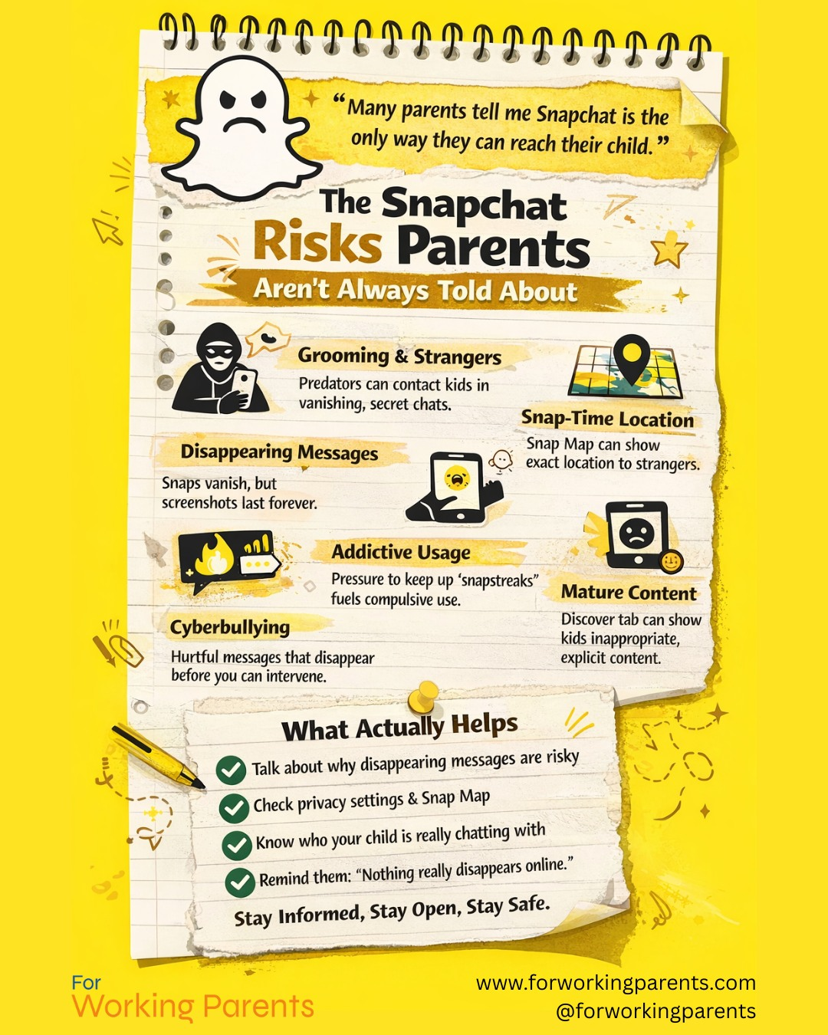
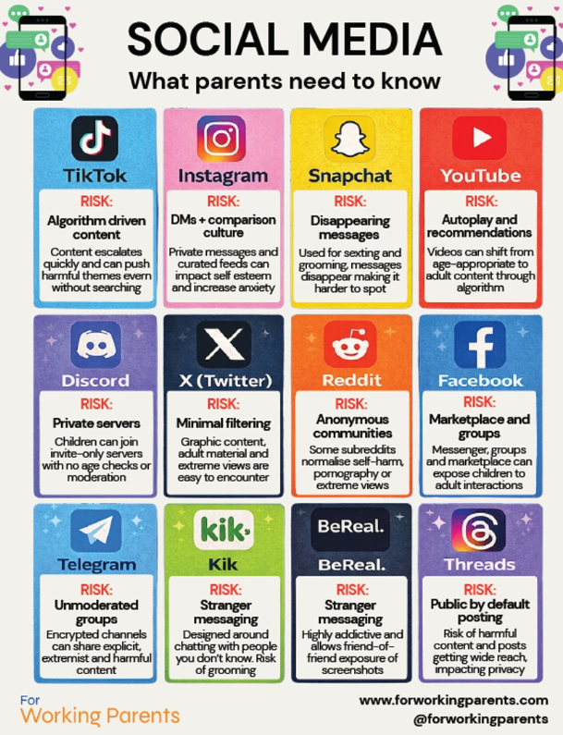
Notes:
To print out for parents

Slide 29
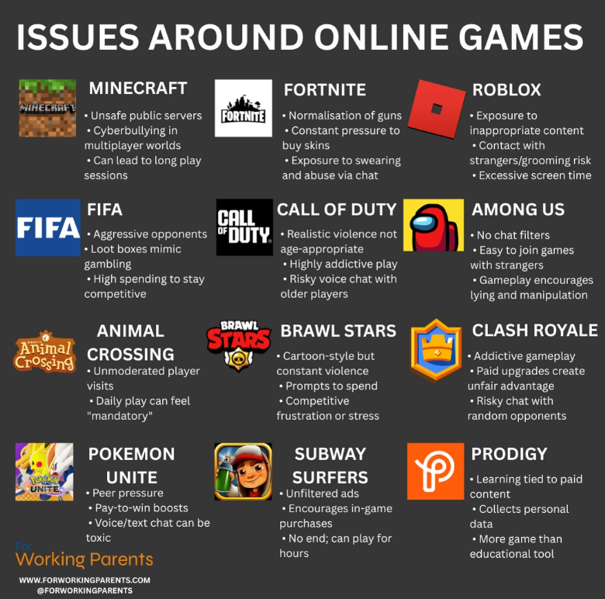
Notes:
To print out for parents

